Slide 1
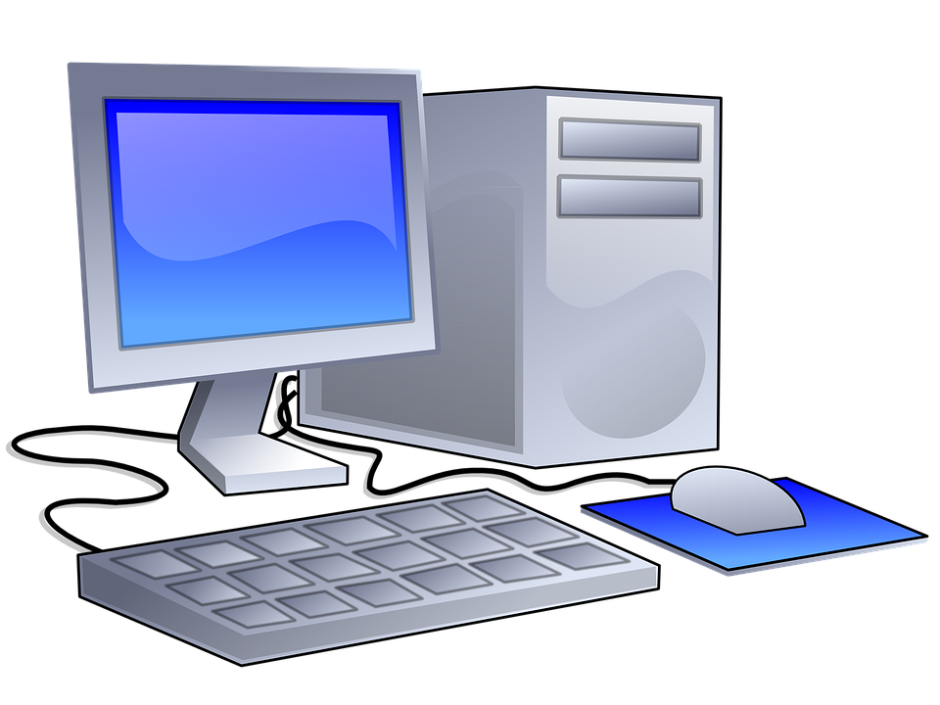
Maven Repositories
Local Repository
Remote Repository

Slide 2
Maven Lifecycles, Phases, & Goals
Clean Lifecycle
Default Lifecycle
Site Lifecycle
pre-clean
validate
compile
test- compile
integration-test
pre-site
clean
initialize
process-classes
process-test-classes
post-integration-test
site
post-clean
generate-sources
generate-test-sources
test
verify
post-site
process-sources
process-test-sources
prepare-package
install
site-deploy
generate-resources
generate-test-resources
package
deploy
process-resources
process-test-resources
pre-integration-test

